Slide 1
Final project: Traveling Salesman Problem (TSP)
Names: Connor Donegan and Cole Strubhar
Fall 2025, CS412

Slide 2
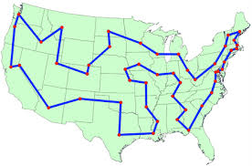
Traveling Salesman Problem - Problem Description
Given an undirected graph G = (V, E) with edge weights c(u,v) > 0
Find a tour: a simple cycle that visits every vertex exactly once
Goal: Minimize the total sum of edge weights in the tour
Also called a Hamiltonian cycle with minimum cost
Notes:
Idea for exact solution (brute force): : https://github.com/tentone/max-clique
Video explaining max clique: https://www.youtube.com/watch?v=gjRcTH2p65c
Greedy: https://discourse.opengenus.org/t/greedy-approach-to-find-a-single-maximal-clique-in-o-v-2-time-complexity/3476

Slide 3
TSP - Decision/Optimization Problem
Optimization problem:
Input: Graph G = (V, E) with edge weights
Output: The minimum-cost tour visiting all vertices
Objective: Minimize Σ(edge weights in tour)
  Decision problem:
  Input: Graph G, integer k
  Output: YES if there exists a tour with total cost ≤ k, NO otherwise

Slide 4
TSP - Use and Importance Examples
Why is TSP Practical and Important?
Real-world Applications:
Logistics: Delivery route optimization (UPS, FedEx, Amazon)
Manufacturing: Drill path optimization on circuit boards
Robotics: Path planning for warehouse robots
Impact: Even small improvements (1-2%) save millions in fuel costs and time for companies
Notes:
One more slide abour results
For each one you need to show results for approximate and exact
- Show the size of the vertex cover?
Optimizationa and decision problem first
Then exact and and approximate solution
One campirson on runtime and results
Same test for approximate and exact make a graph from that on the differents and reuslts of hte test
show differences between approxo and exact solution
Compare the results. Exact solution what is the optimal solution

Slide 5
TSP is in NP - Certificate Verification
Certificate: A tour (sequence of vertices)
Verification Algorithm (Polynomial Time):
Check tour visits each vertex exactly once - O(n)
Check tour forms a valid cycle - O(n)
Calculate total edge weights - O(n)
Verify total ≤ k - O(1)
Total: O(n) - Polynomial
Therefore TSP ∈ NP (can verify solutions quickly)

Slide 6
NP Reduction
Proof Strategy:
Hamiltonian Cycle ≤p TSP
If we can solve TSP, we can solve Hamiltonian Cycle
Reduction:
Given graph G for Hamiltonian Cycle problem
Create weighted graph G' where:
  If edge exists in G: weight = 1
  If edge doesn't exist in G: weight = 2
  Set k = n (number of vertices)
G has Hamiltonian cycle ⟺ G' has TSP tour with cost ≤ n
Conclusion: TSP is NP-Complete
Notes:
3-SAT to Max Clique, the runtime ratio is O(n^m), where n represents the size of the problem input and k, m are polynomial exponents associated with the respective algorithms.
N the number of the clauses in the 3 sat problem
m is an exponent that quantifies the relationship between the input size n and the computational effort (e.g., time or space complexity) required to perform the reduction from 3-SAT to Max Clique.

Slide 7
Example Inputs/Outputs
Input:
3 3
A B 1
B C 1
A C 1
Output:
Tour: A → B → C → A
Cost: 3
Input:
4 6
A B 1
B C 1
C D 1
D A 1
A C 10
B D 10
Output:
Tour: A → B → C → D → A
Cost: 4

Slide 8
Exact Code Solution
Algorithm Type:
Greedy: Check every possible variation of travel for the ”best” result.
Anytime: Produces optimal tour regardless of starting node.
Non-deterministic: Will always produce an optimal tour, but may differ if multiple paths have the same cost.
Run Time: O(n!)

Slide 9
Exact Code Solution - Pseudocode
Runtime Analysis
Work done within while:
v E n iterations
Work addressed by while:
n * (n - 1) * (n - 2)…
Combined:
(n^2)!
while !empty(stack):
node = stack.pop()
path.append(node)
if start_node(node):
if shortest(path):
shortest_path = path
for (edges):
if !edge_traveled(edge): // Memozation required!
stack.append(dest_node)
return shortest_path

Slide 10
Approximation Strategy: Greedy Nearest-Neighbor
Algorithm Type:
Greedy: Makes locally optimal choice at each step
Anytime: Produces valid tour at any point
Deterministic: Same graph → same result
How It Works:
Start at arbitrary node
Repeat until all visited:
  Find nearest unvisited neighbor
  Move to that neighbor
  Mark as visited
Return to start node
Runtime: O(n²) - Polynomial time guaranteed

Slide 11
Greedy Nearest-Neighbor Pseudocode
function GreedyNearestNeighbor(graph, start_node):
visited ← {start_node}
tour ← [start_node]
current ← start_node
while |visited| < n:
unvisited ← all nodes - visited
nearest ← argmin{distance(current, node)
for node in unvisited}
tour.append(nearest)
visited.add(nearest)
current ← nearest
tour.append(start_node) // return to start
return tour
Time Complexity Analysis:
Main loop: n-1 iterations
Finding nearest: O(n) per iteration
Total: O(n²)

Slide 12
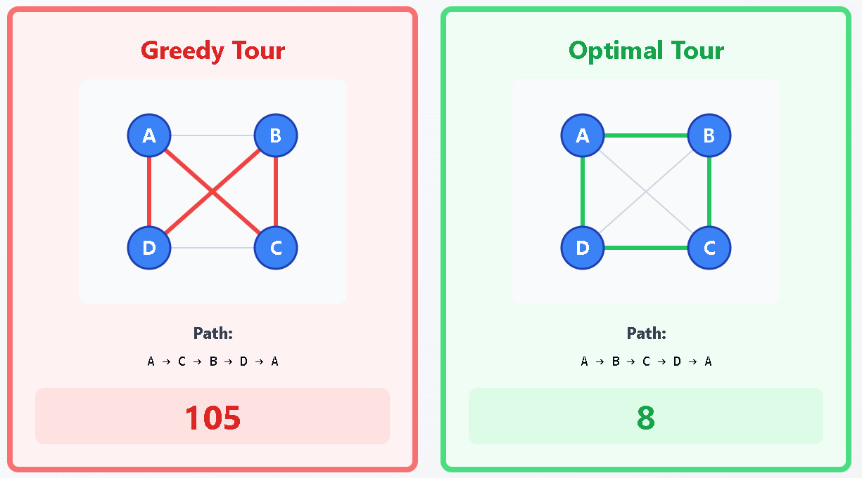
Problem Instance Where Approximation ≠ Optimal
Edges:
Square edges: A-B=2, B-C=2, C-D=2, D-A=2
Diagonal: A-C=1 (cheap shortcut)
Diagonal: B-D=100 (expensive!)
Results:
Greedy Tour: A → C → B → D → A = 1 + 2 + 100 + 2 = 105
Optimal Tour: A → B → C → D → A = 2 + 2 + 2 + 2 = 8
Ratio: 106/8 = 13.25× worse!

Slide 13
Approximate Code Solution
Theoretical Bounds:
General Graphs: Unbounded approximation ratio
  No constant-factor guarantee
  Can be arbitrarily bad (as seen in slide 12)
Empirical Performance:
Random instances: typically 1.2 - 1.5× optimal
Often 25-30% worse than optimal in practice
Much better than worst-case suggests
Trade-off:
Sacrifice optimality for O(n²) polynomial speed
Brute force: O(n!) - infeasible for n > 20
Greedy: O(n²) - feasible for n = 100,000+

Slide 14
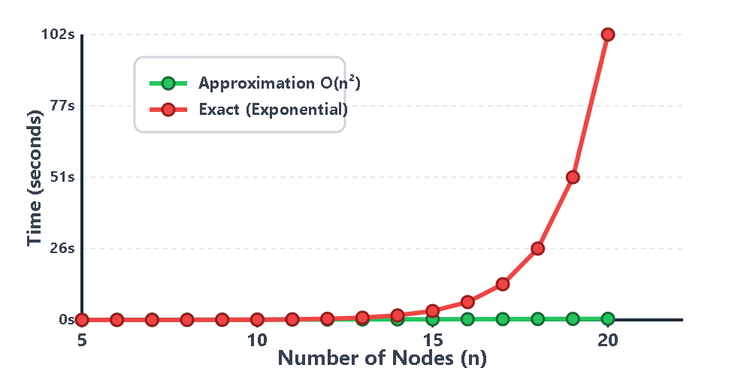
Runtime (Wall-Clock) Performance Graph
Key Observation: Exact becomes expensive around n=15-20, while approximation scales easily

Slide 15
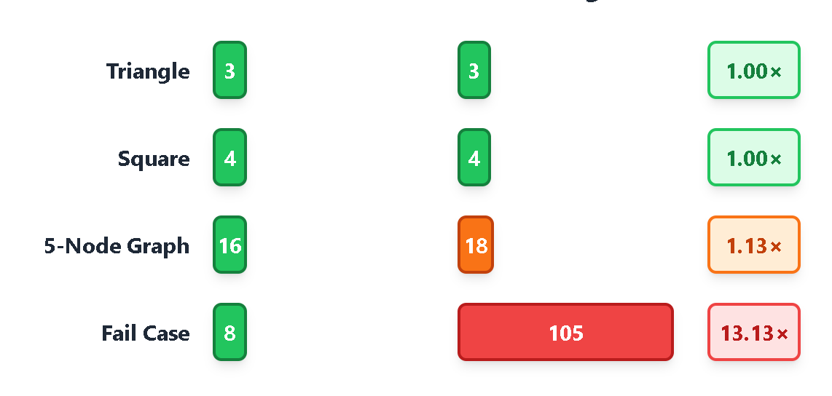
Solution Quality
Takeaways: Greedy typically within 1.2-1.5× of optimal

Slide 16
Works Cited
Erickson, Jeff. Algorithms. [Chapter on NP-Hardness]
CS412 Course Materials: Approximation Algorithms Lecture Notes
Geeks for geeks https://www.geeksforgeeks.org/dsa/traveling-salesman-problem-tsp-in-python/
Copilot and Claude to help create graphics

